Slide 1


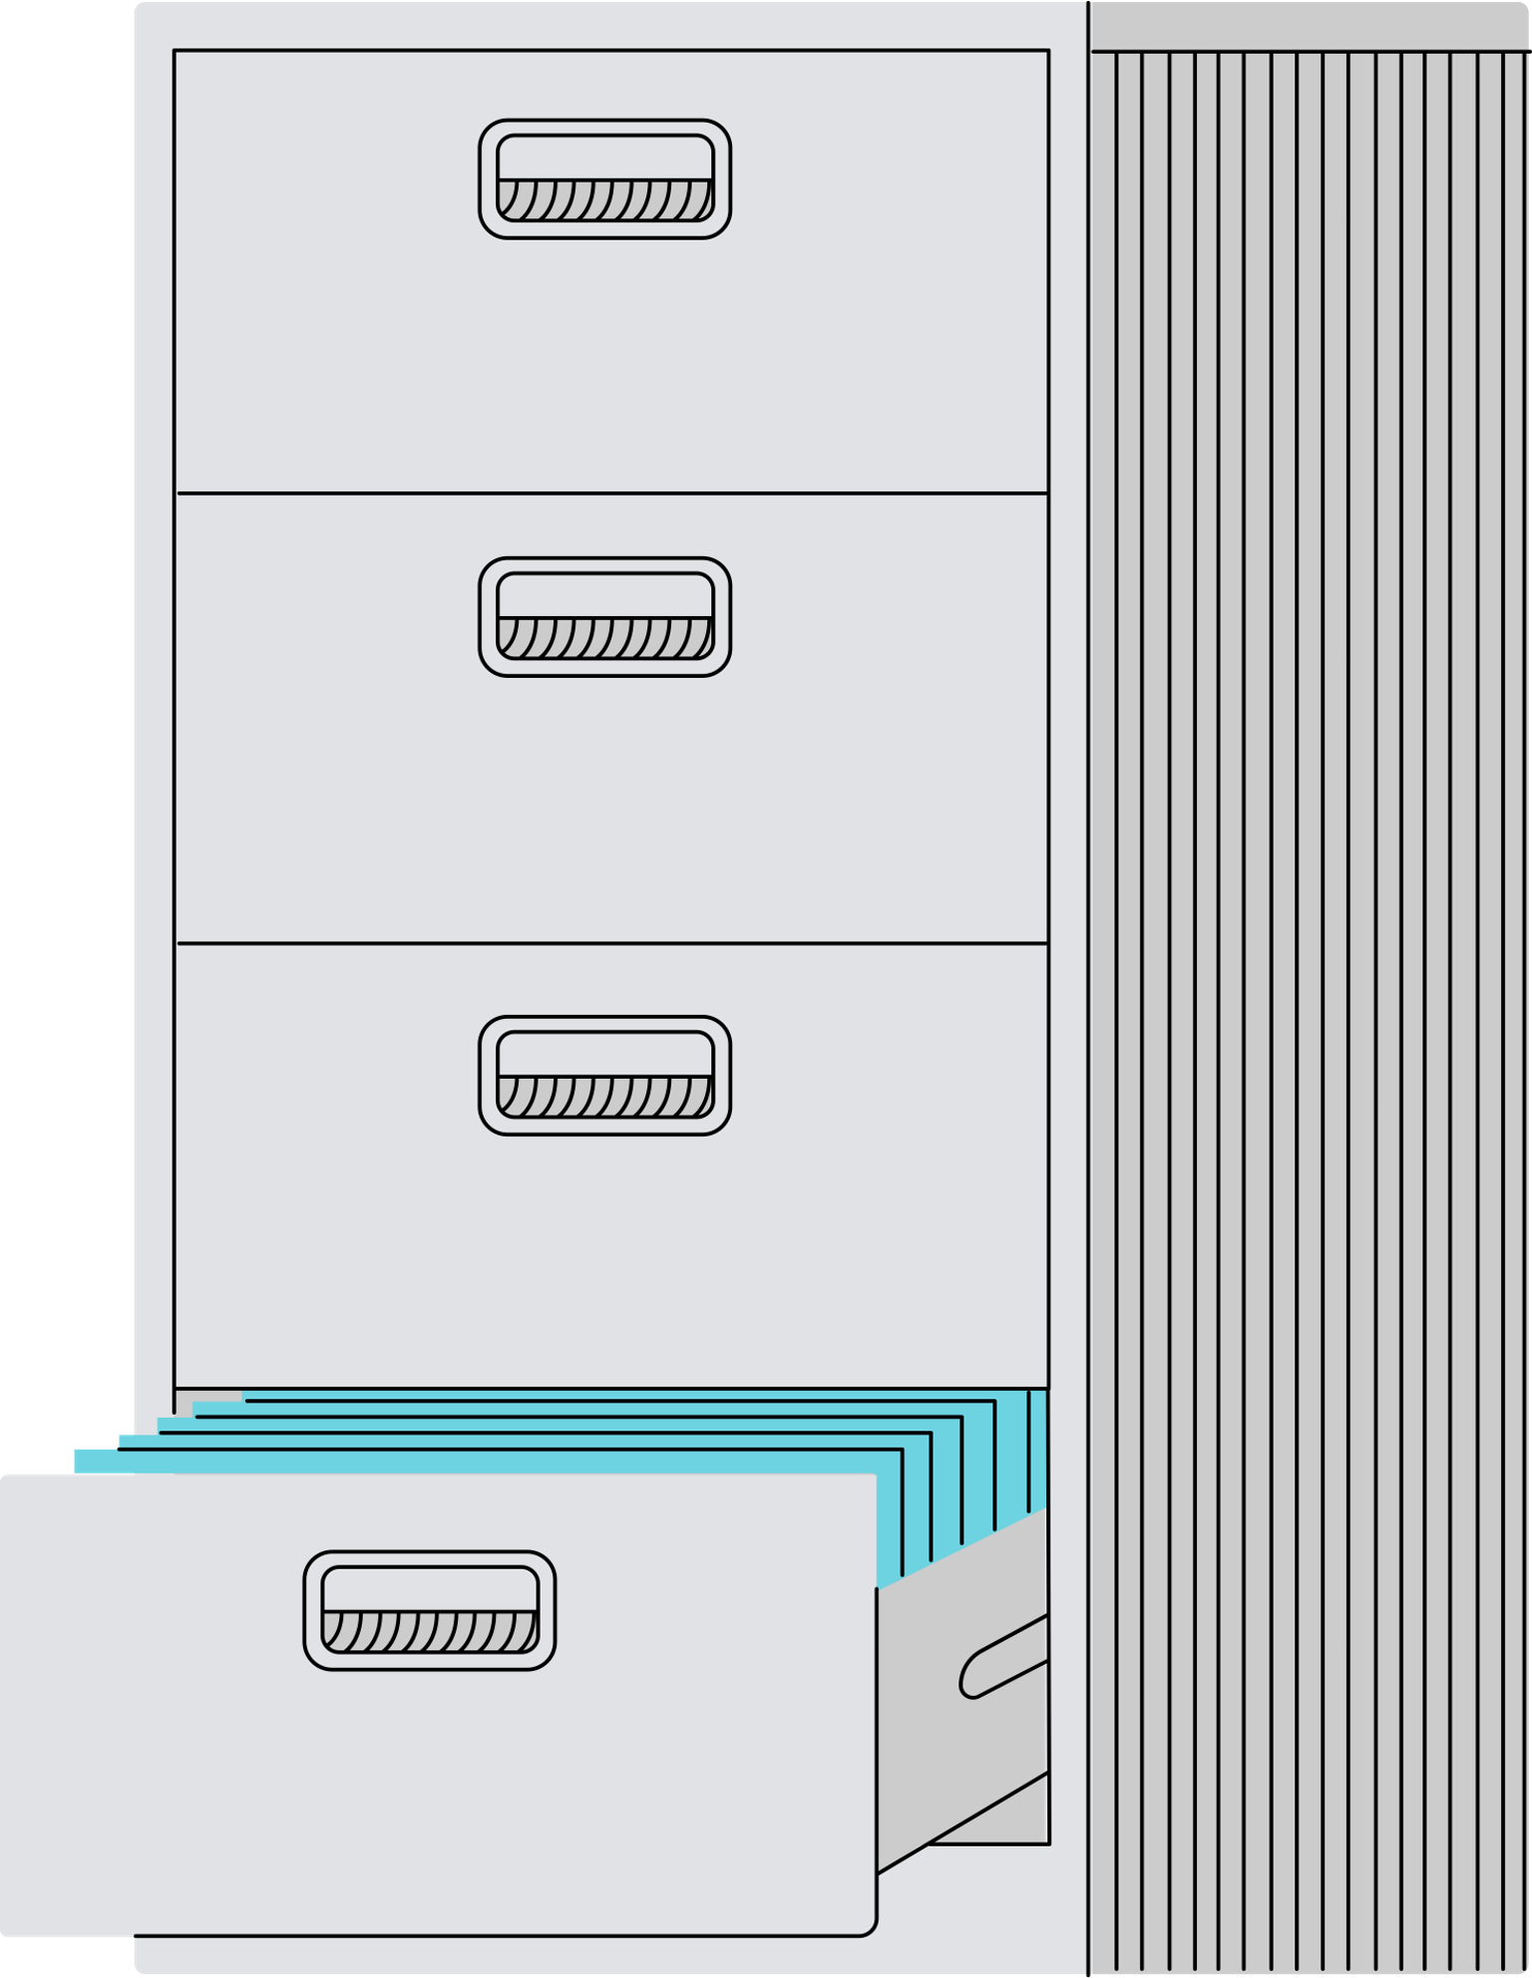



Automated Payroll System
Aurpita Barua (2104010202160)
Nusrat Warida Saima(2104010202163)
Bobi Barua(2104010202165)

Slide 2

Outlines
Introduction
Motivation
Features
Methodology
Selected Screenshots
Limitations & Future Work
Conclusion
References

Slide 3




Introduction
Automate payroll management, including attendance tracking and payroll generation.
Improve efficiency, reduce manual errors, and streamline payroll processing.

Slide 4

Motivation
Manual payroll processes are time-consuming and prone to errors.
Need for a system that integrates attendance, employee management, and payroll generation.
To enhance compliance with tax regulations and improve overall accuracy.

Slide 5
Features
User access
Employee management
Attendance tracking
Payroll generation
Admin and Employee access with specific functionalities.
Add, update, and manage employee data.
Automated salary calculations, tax deductions, and payslip generation.
Employees mark attendance daily.
4
1
2
3

Slide 6


Methodology
Database Design
1
Workflow
2
Use Case Diagram
3

Slide 7
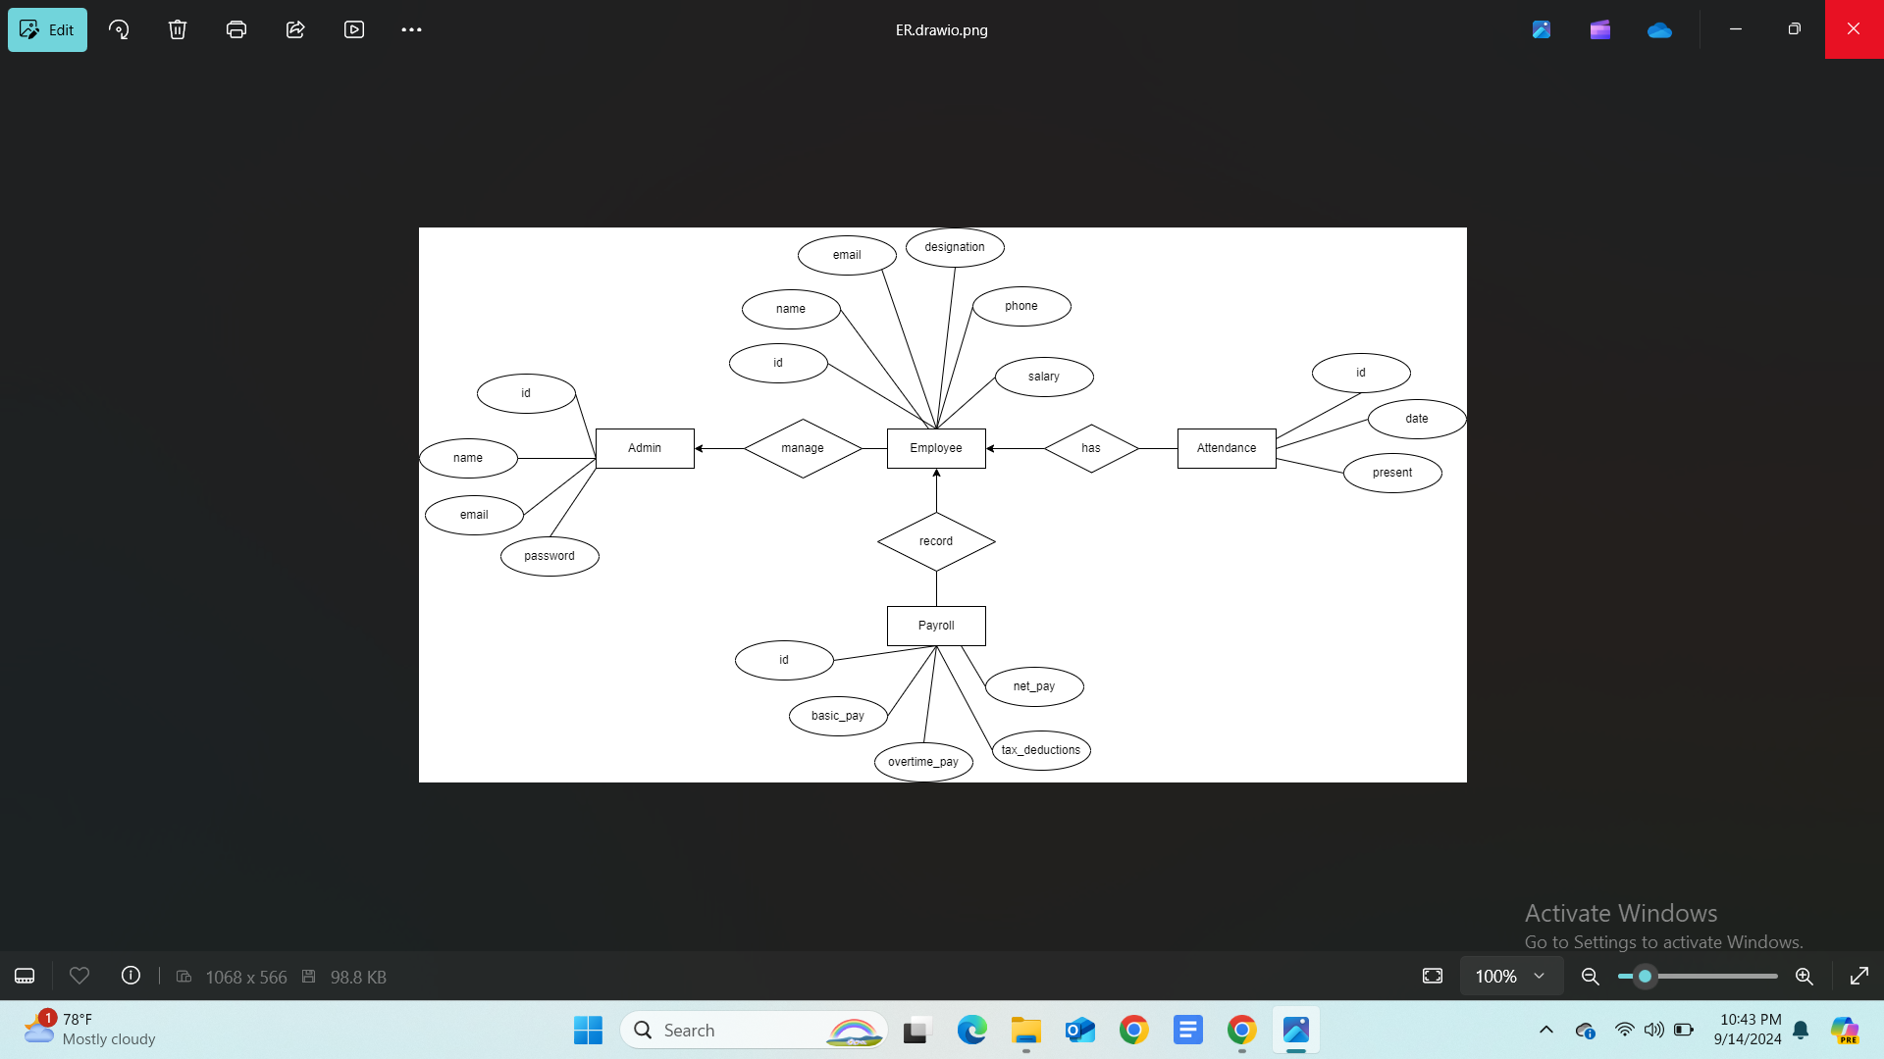
Methodology Cont.
Database Design

Slide 8
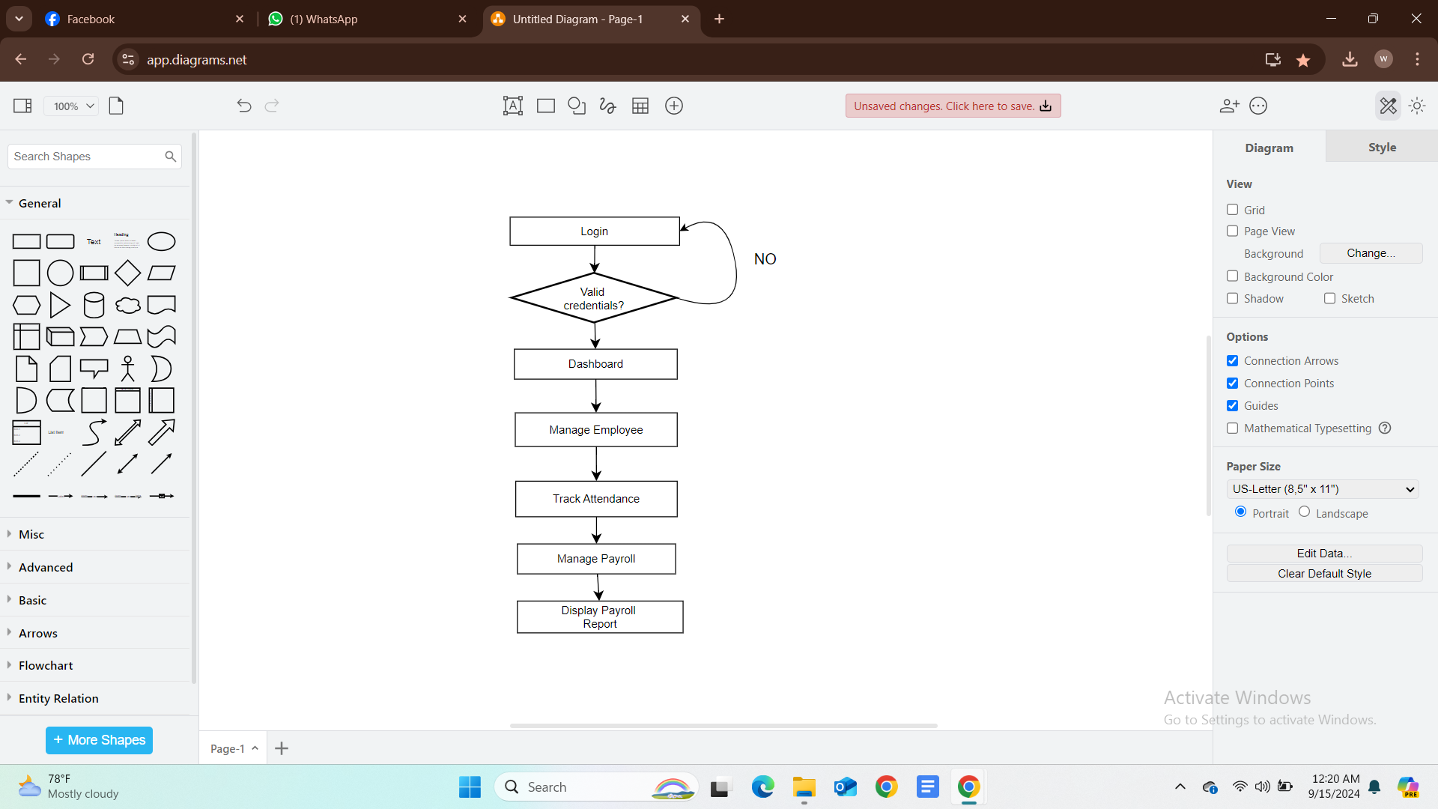
Methodology Cont.
Workflow

Slide 9
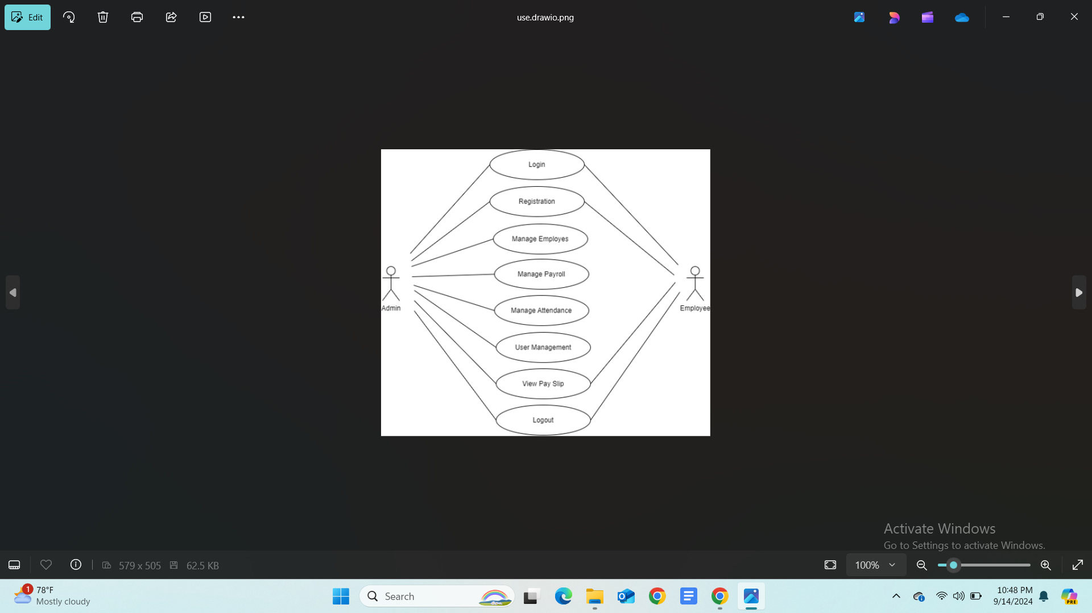
Methodology Cont.
Use Case Diagram

Slide 10
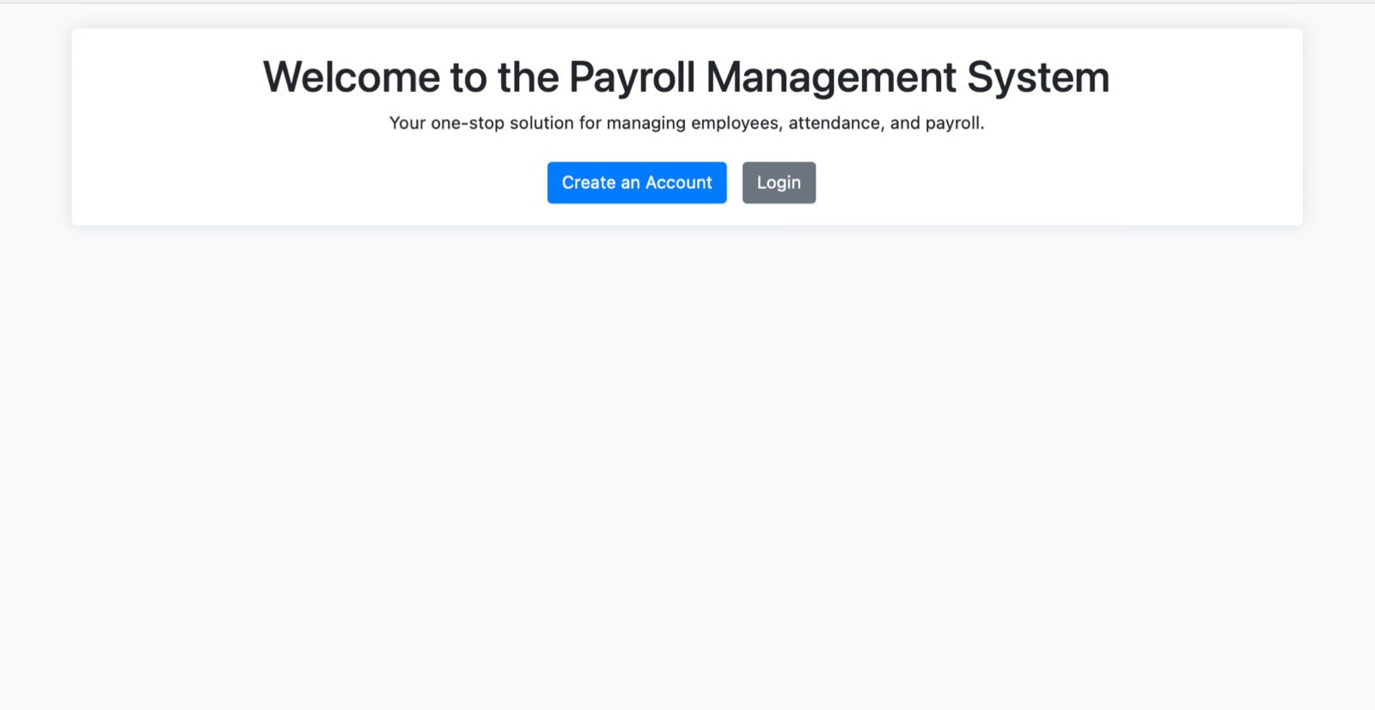
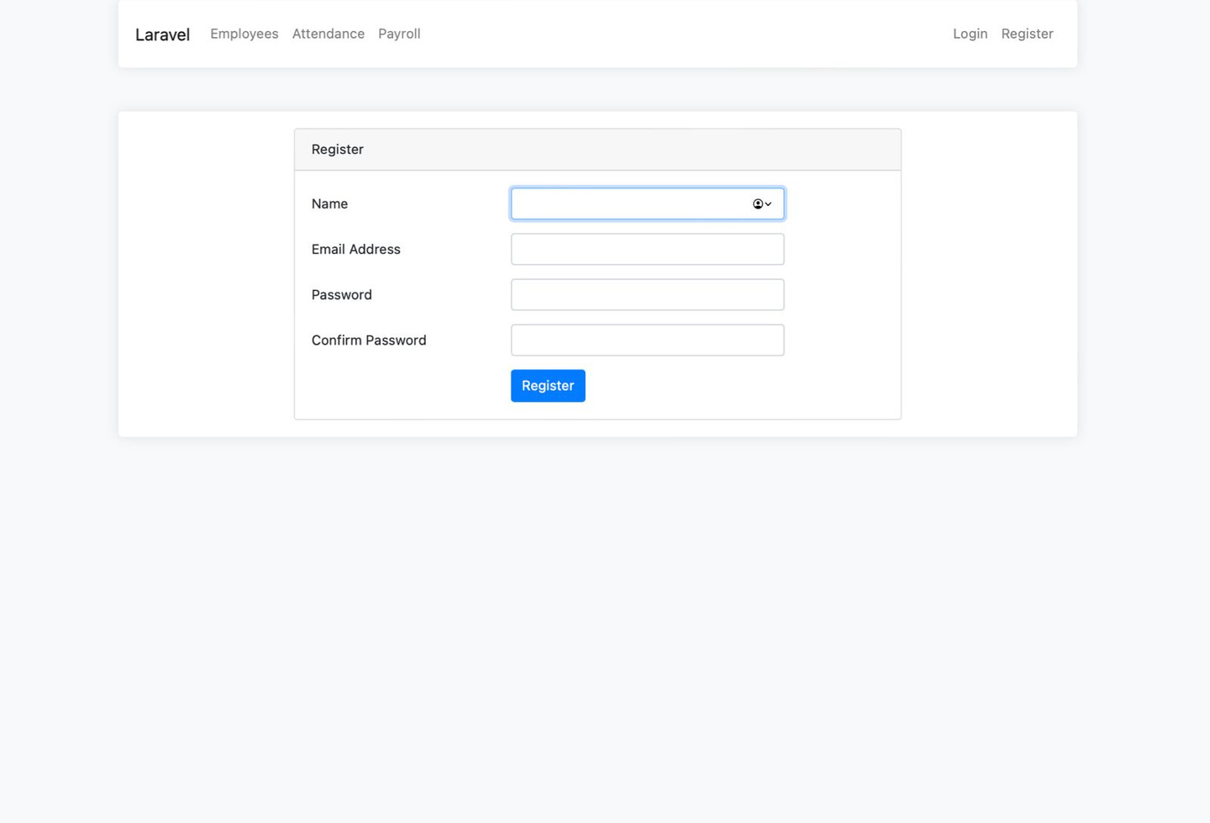
Screenshots
Payroll System’s Interface
Registration Page

Slide 11
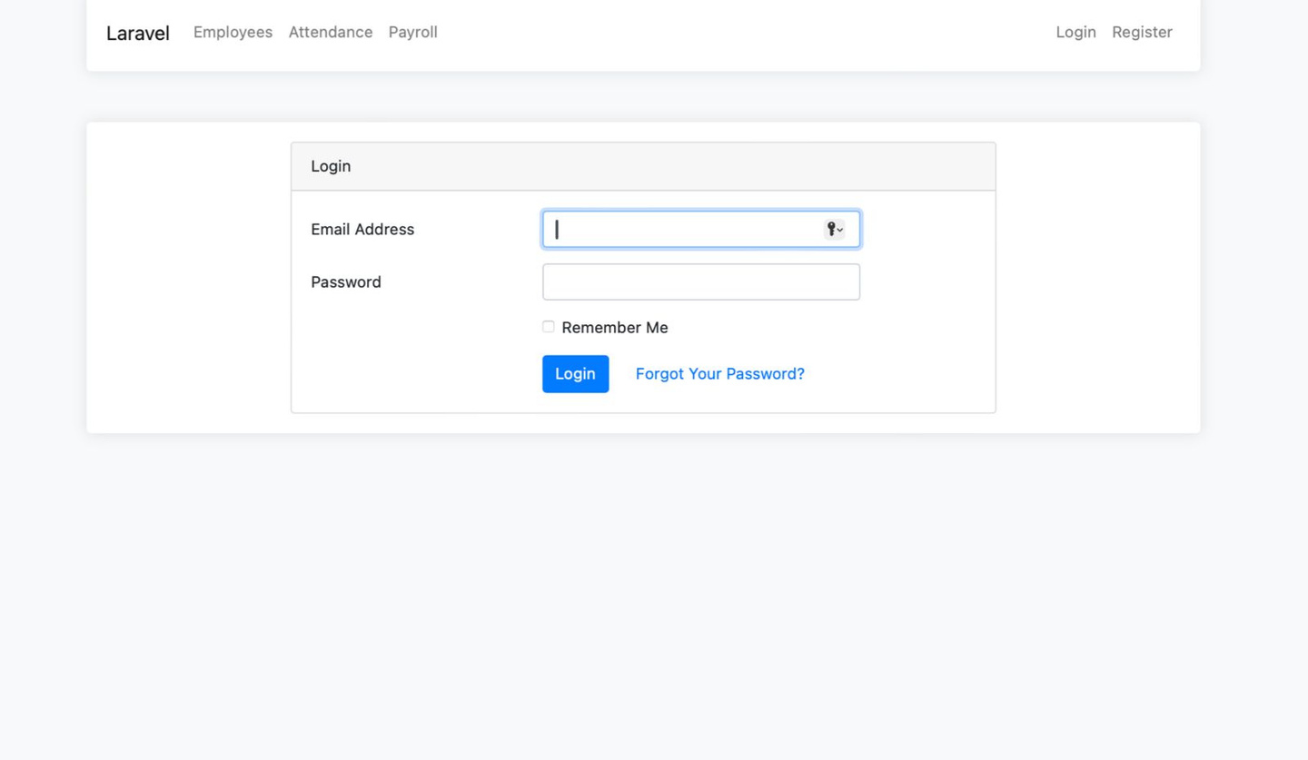
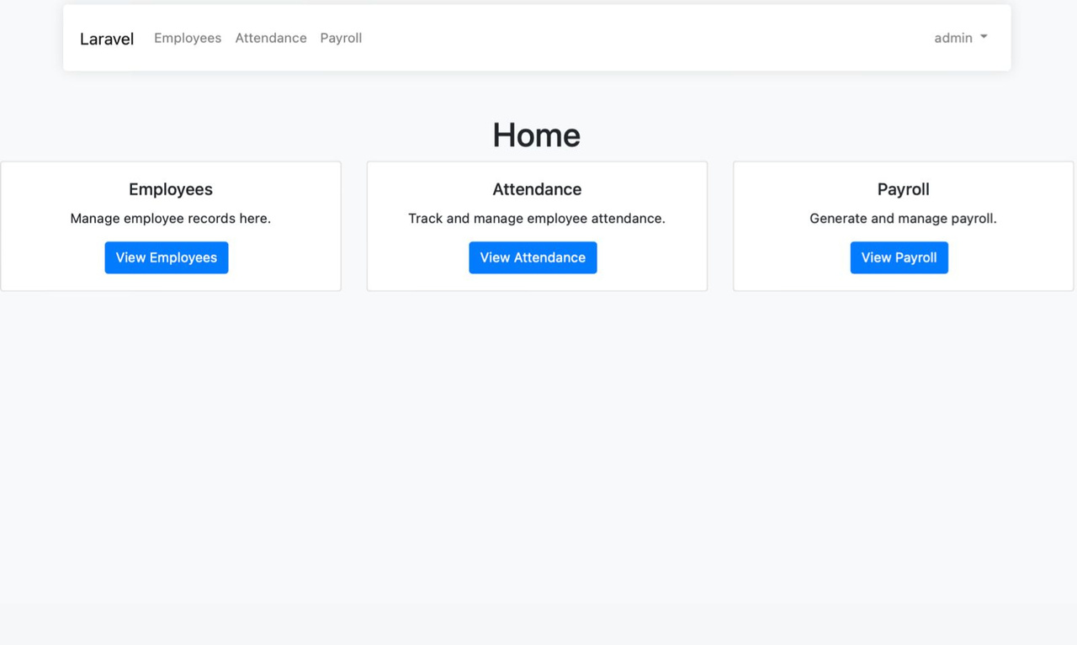
Screenshots Cont.
Login Page
Home Page

Slide 12
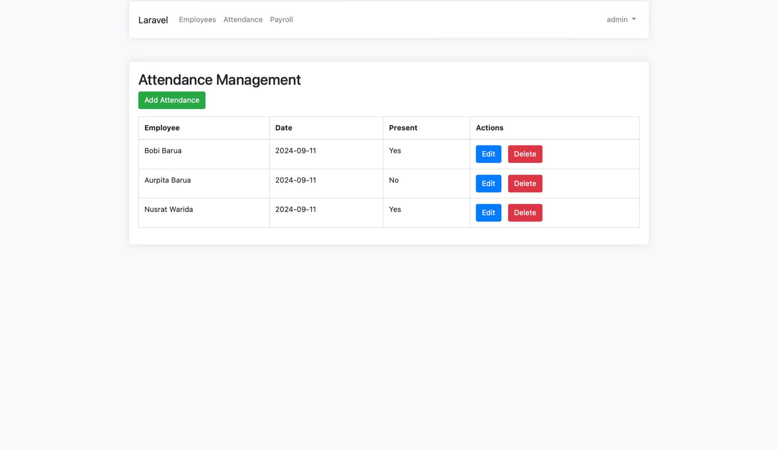
Screenshots Cont.
Attendance Management

Slide 13
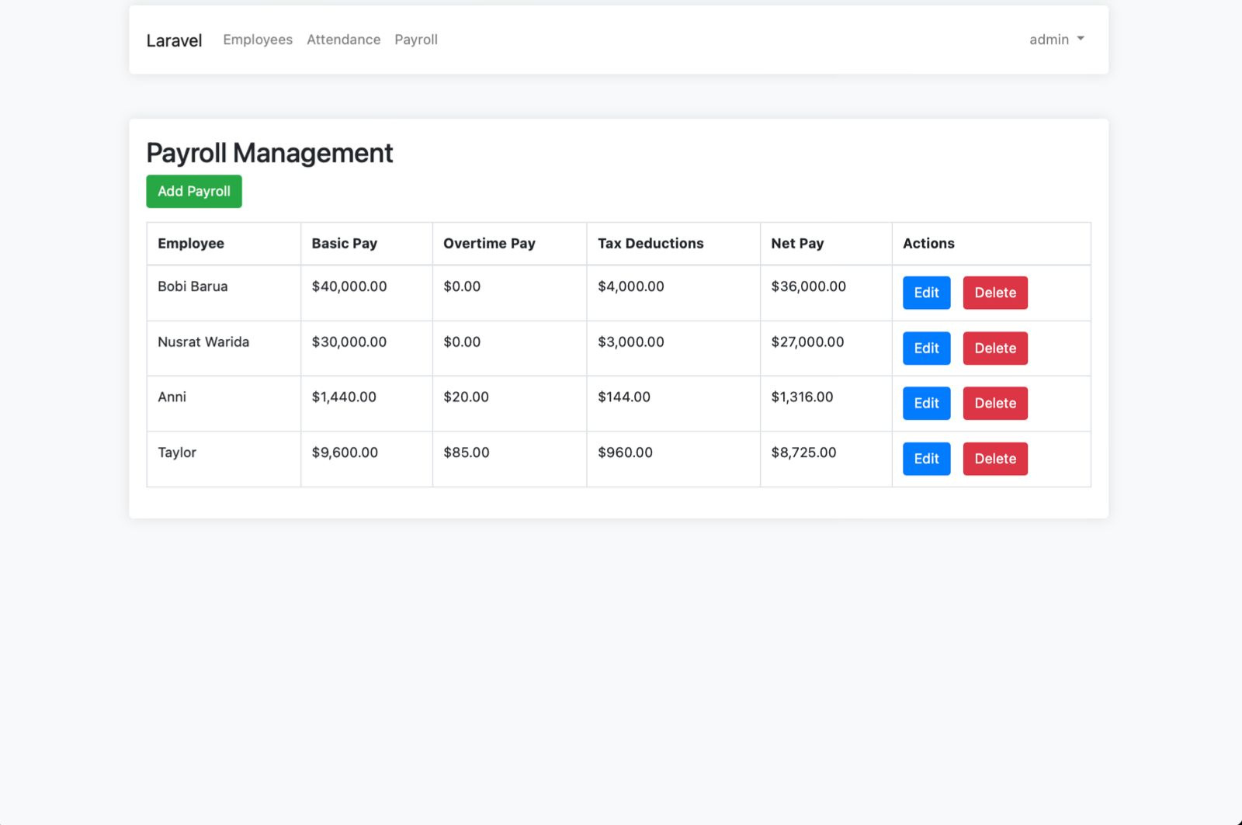
Screenshots Cont.
Payroll Management

Slide 14
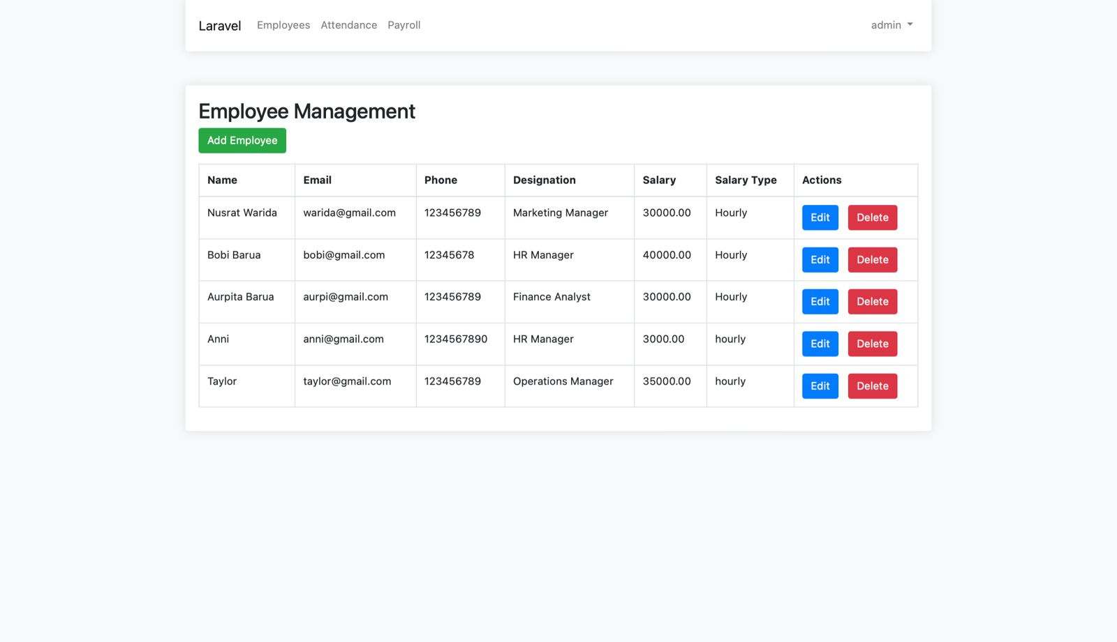
Screenshots Cont.
Employee Management

Slide 15
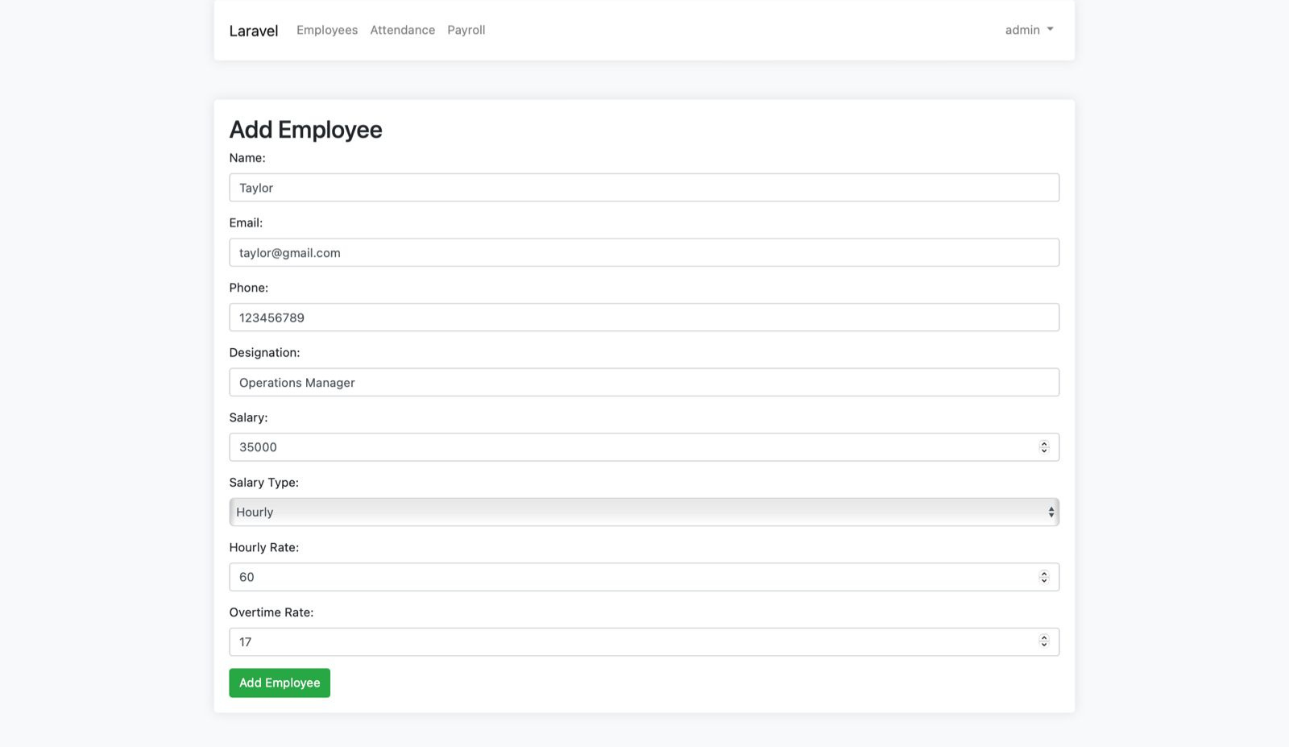
Screenshots Cont.
Add Employee

Slide 16
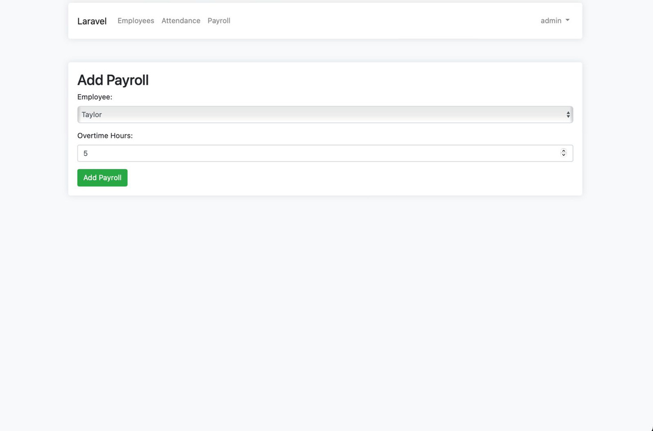
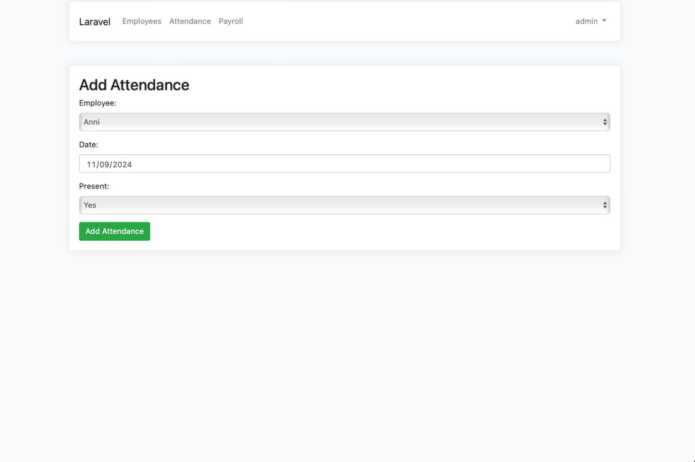
Screenshots Cont.
Add Payroll
Add Attendance

Slide 17
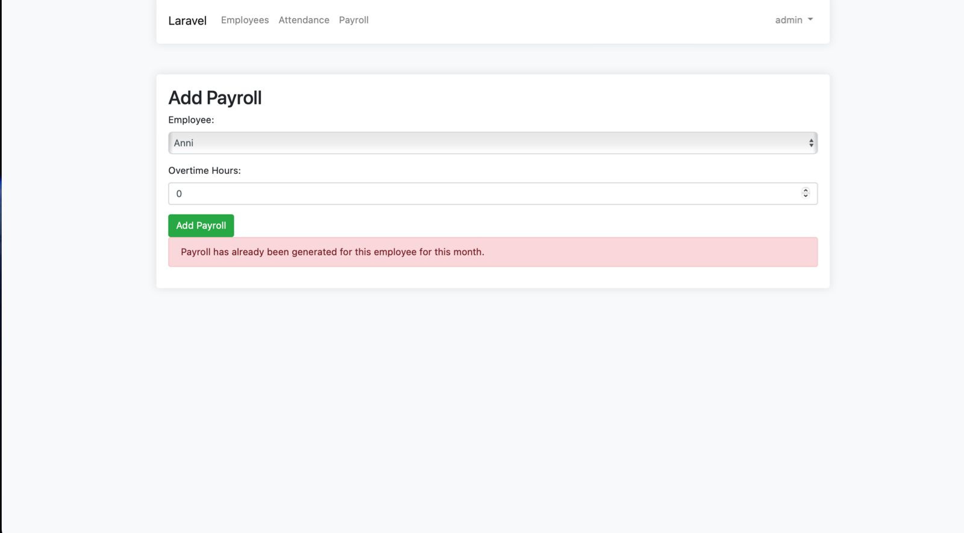
Screenshots Cont.
Payroll Constraint

Slide 18

Limited Access for Employees: Employees can only view payroll slips but cannot request leave or check old records.
No Integration with Bank Systems: Direct salary deposits to bank accounts are not automated within the system.
LIMITATIONS
No Support for Multi-Currency: The system is restricted to single currency payroll, which can be a limitation for international companies.

Slide 19

Leave and Overtime Management: Integrate leave requests, approvals, and overtime calculations into the payroll system.
Bank Integration: Add functionality to process direct salary transfers to employee bank accounts.
Future Works
Multi-Currency Support: Enable the system to handle payroll in multiple currencies for global businesses.

Slide 20

Conclusion
The system automates key payroll functions, significantly reducing
manual errors.
It provides an efficient and scalable solution for managing employee
data, tracking attendance, and generating payroll reports.
Future enhancements will further improve its functionality and user
experience.

Slide 21
References
[1] K. Mahajan, S. Shukla, and N. Soni, “A review of computerized payroll system,” Inter-
national Journal of Scientific Research in Computer Science, Engineering and Infor-
mation Technology, vol. 5, no. 2, pp. 142–147, 2019.
[2] W. S. Thieke, “Payroll made easy: Developing a web-based system for student em-
ployee payroll,” Journal of Information Technology Education, vol. 9, pp. 245–253,
2010.
[3] R. Wintarto, “Automated part-time payroll system based on attendance,” Journal of
Software Engineering and Applications, vol. 13, pp. 131–140, 2020.
[4] M. Singh, P. Singh, R. Singh, S. Singh, and S. Gupta, “Leave and payroll manage-
ment system,” International Journal of Computer Science and Information Technology,
vol. 9, pp. 44–52, 2018.
[5] U. Ikechukwu, “Design and implementation of an automated payroll system: A case
study of the nigerian communications commission,” Journal of Applied Computer Sci-
ence Mathematics, vol. 12, no. 4, pp. 57–65, 2019.
[6] Ahmed et al., “Web-based payroll management system: Design, implementation, and
evaluation,” Kurdistan Journal of Applied Research, vol. 5, no. 1, pp. 123–132, 2020.

Slide 22




Thank You!

